Slide 1
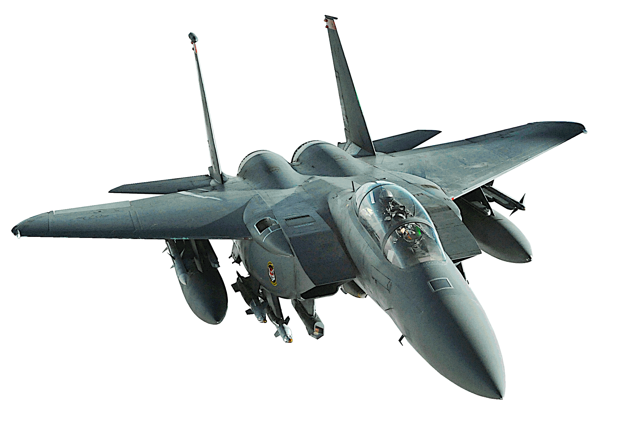
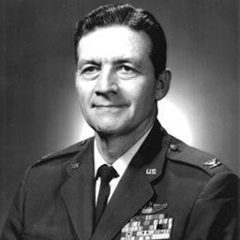
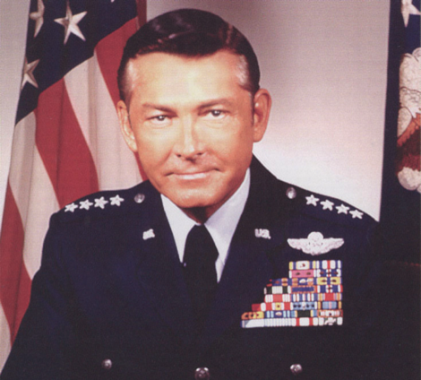
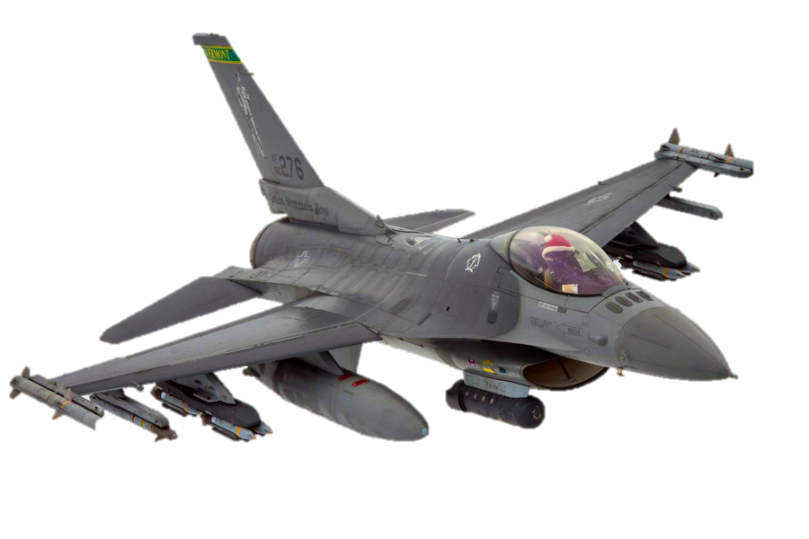
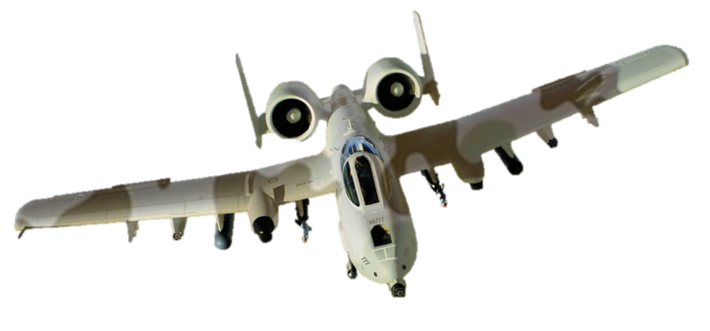
Gen. “Bill” Creech, John Boyd
Eagles, Falcons & Warthogs
The story of two iconic USAF leaders who championed competing visions for the future of tactical aviation in the wake of Vietnam
Notes:
Teddy Roosevelt and the Rough Riders at San Juan Hill

Slide 2
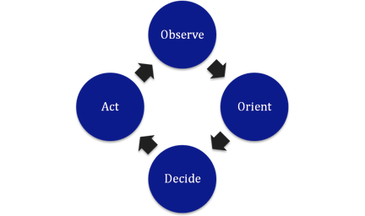
OODA

Slide 3
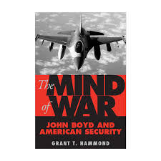
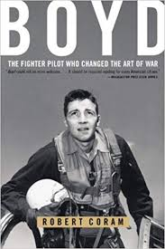
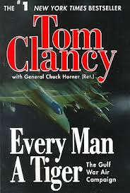
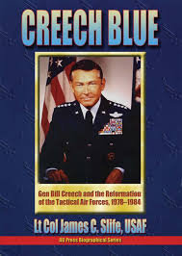
Narratives

Slide 4
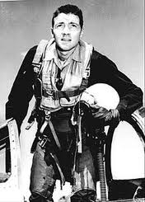
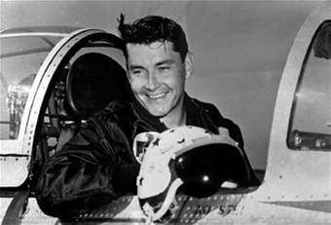
Different Strokes

Slide 5
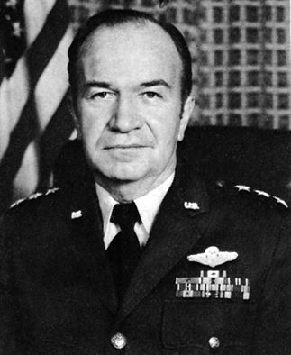
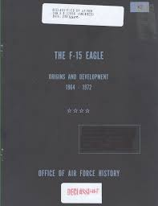
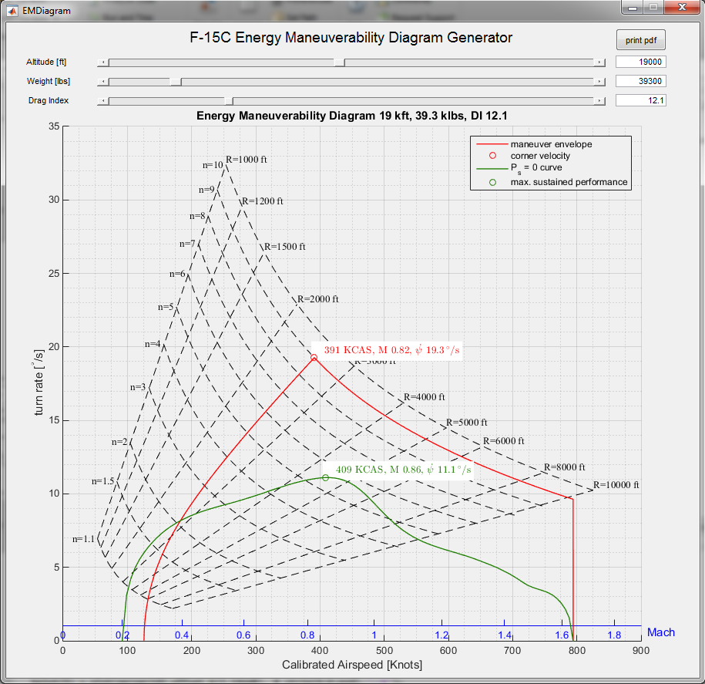
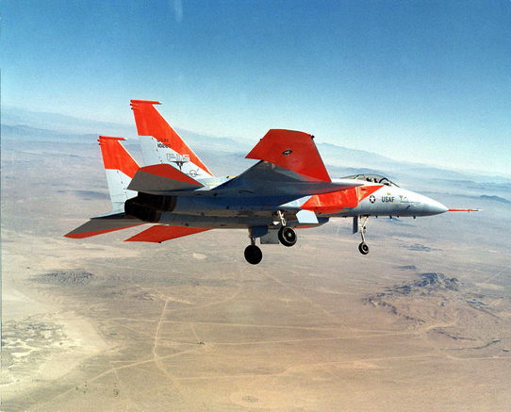
F-15 Eagle

Slide 6
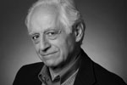
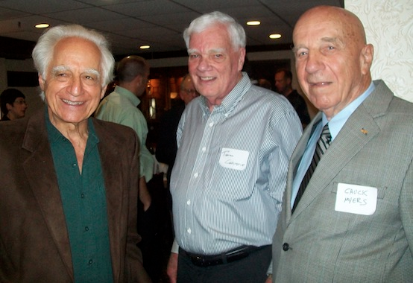
“Fighter Mafia” & the DRM
Air to Air combat advocates; Everest Riccioni, Pierre Sprey
Arguing against complexity and growing expense of modern weaponry
James Burton’s debacle over the Bradley Fighting vehicle, “Pentagon Wars”
Bill Lind, Dick Cheney, Noel Fallows, Mike Wylie, Newt Gingrich,Franklin Spinney, all DRM

Slide 7
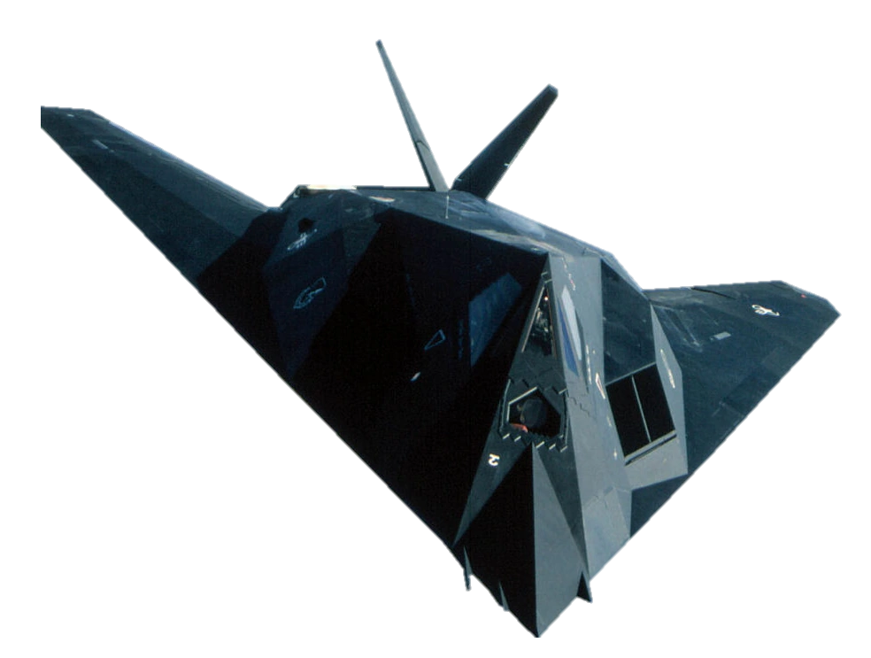
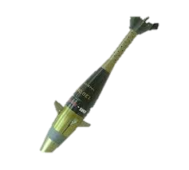
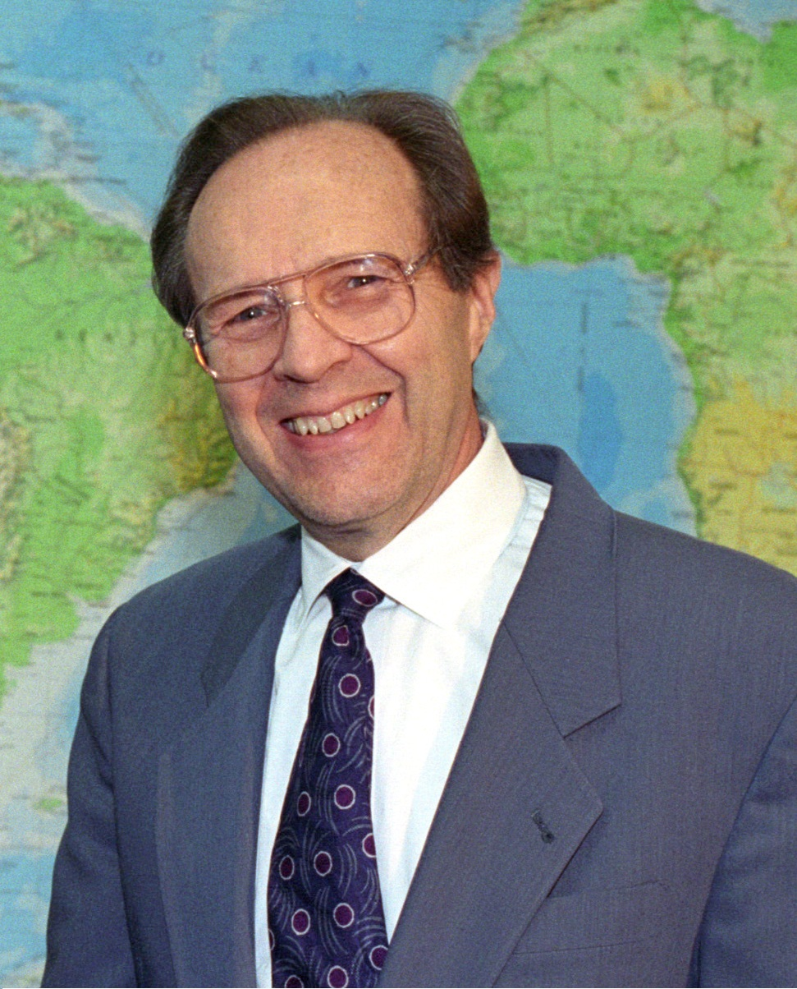
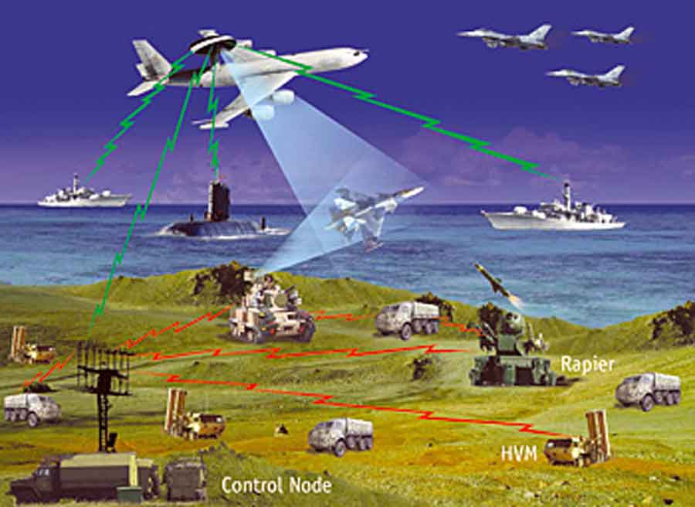
William J. Perry

Slide 8
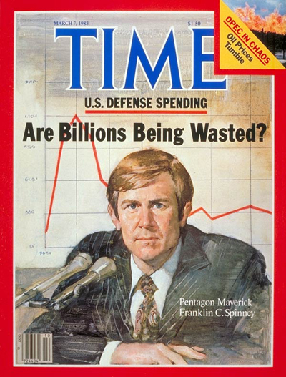
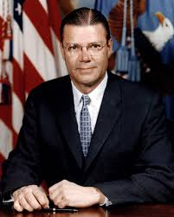
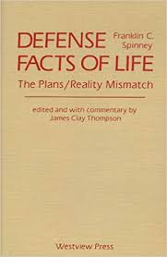
LoE 1: PPBS & PA&E

Slide 9
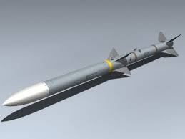
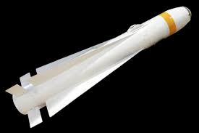
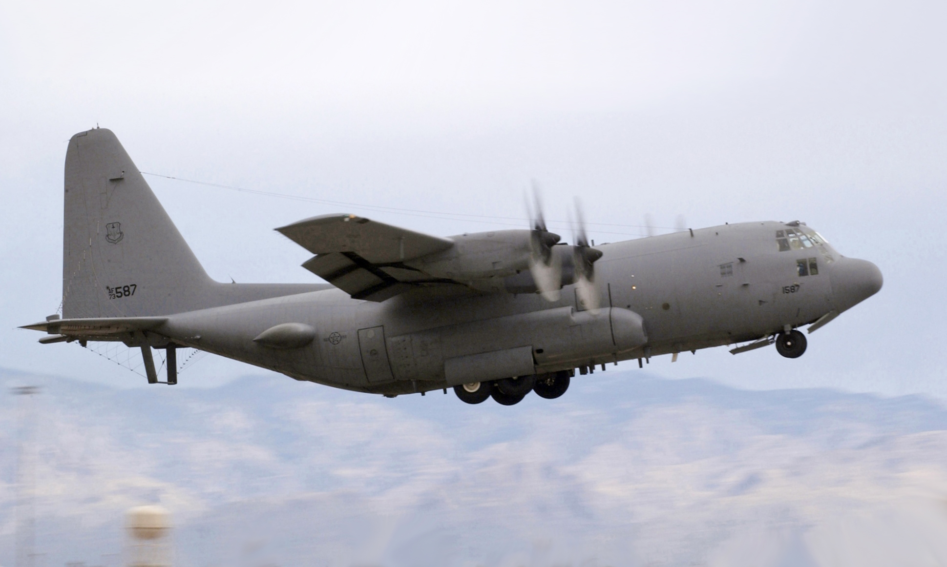
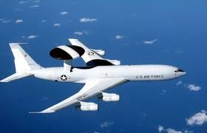
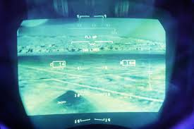
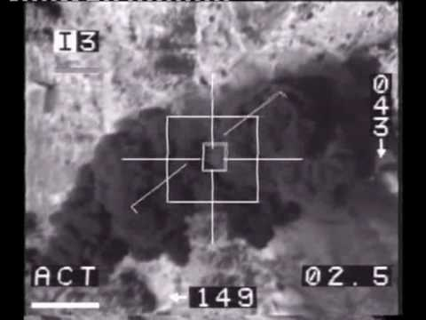
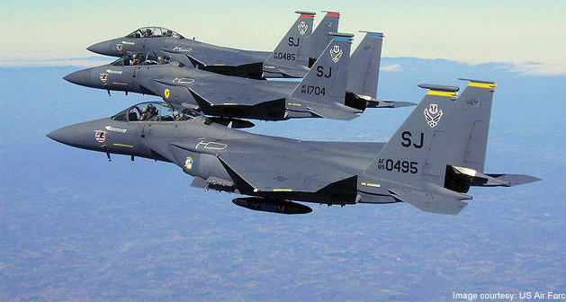
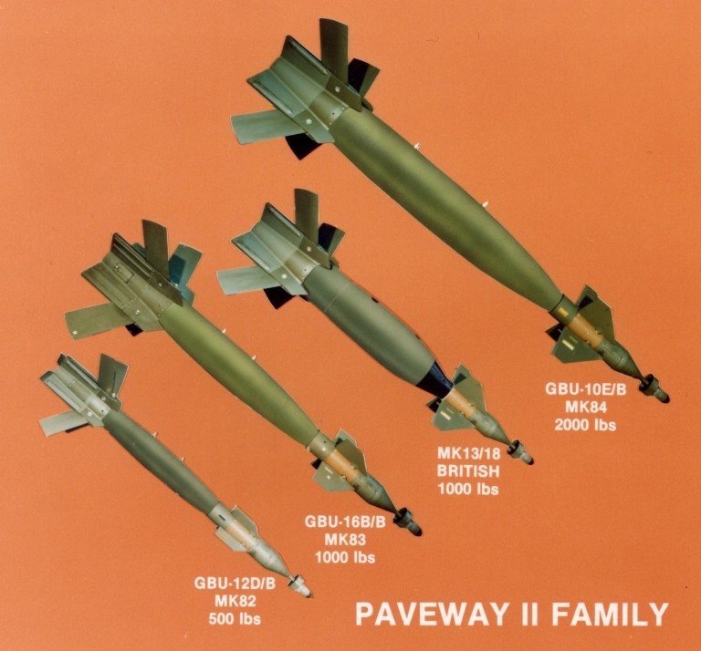
Programs in the Crosshairs

Slide 10
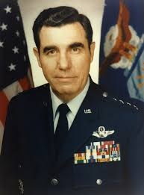
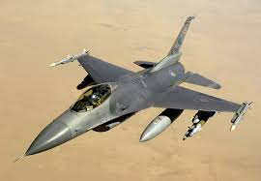
The F-16 becomes Multi-Role

Slide 11
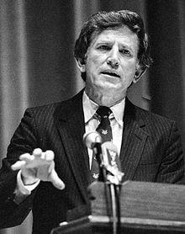
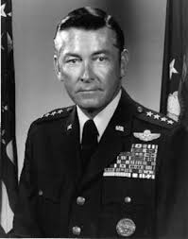
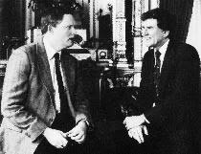
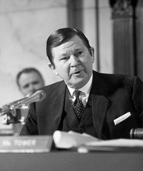
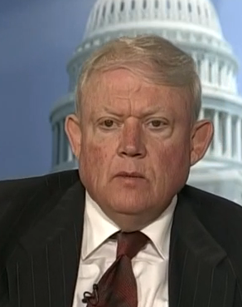
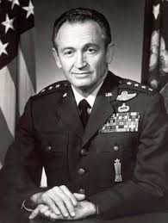
LoE #2: Congress

Slide 12
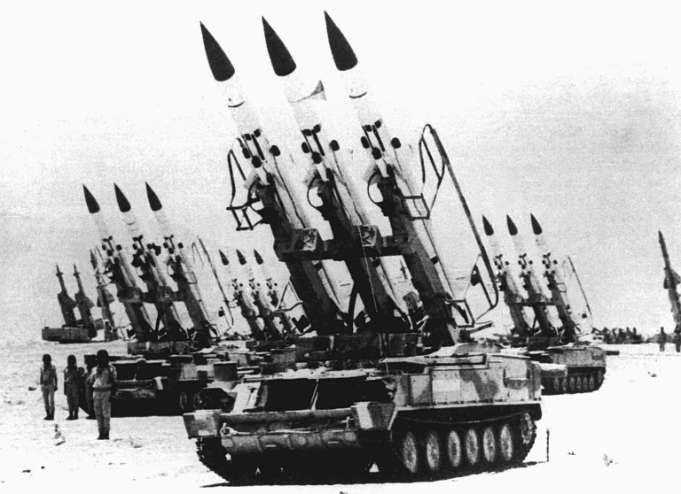
Yom Kippur War

Slide 13
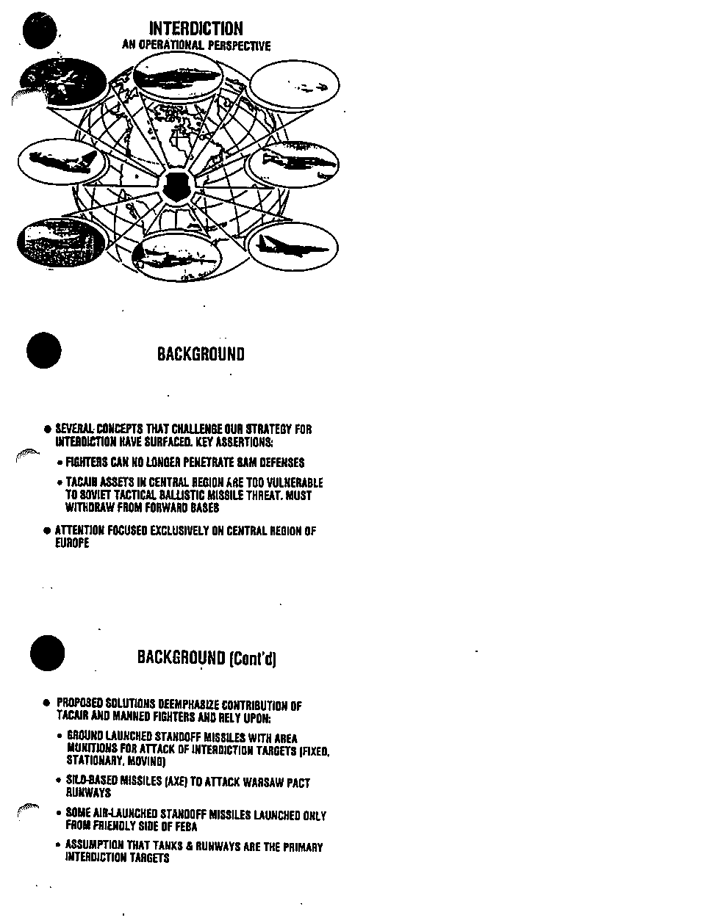
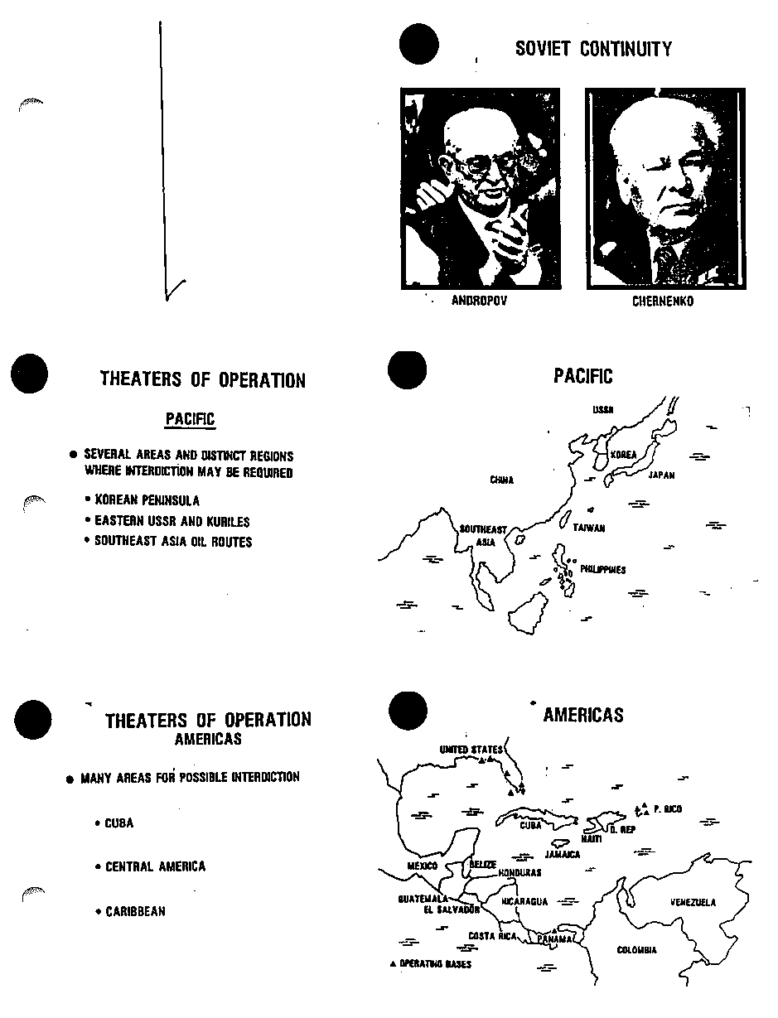
Rollback Briefing

Slide 14
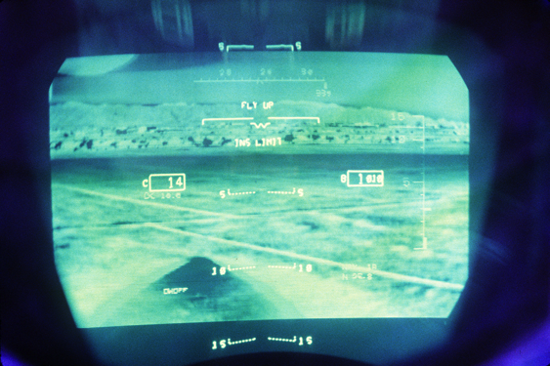
The Establishment’s Vision: The Offset Strategy
Hon. William Perry “Offset” Strategy
Electronic warfare
PGMs
Low Visibility (stealth)
Fewer airframes, more potent and flexible capability
Creech on the Korean war: “We must fight at night; We must fight at night; We must fight at night, We must fight at night.”
LANTIRN program
New “roll-back strategy” for enemy air defenses
Emphasize stand-off and precision weaponry to achieve air superiority and to extend the MK-1 eyeball

Slide 15
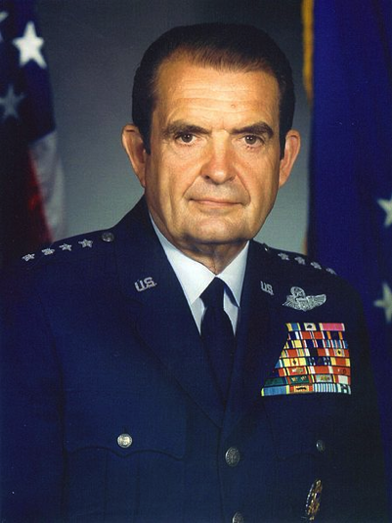
Creech in the Trenches
Protégée of Gen and later USAF Chief of Staff David C. Jones
Earned respect defusing Howze Board efforts to consolidate attack aircraft under U.S. Army control
Embraced F-15, F-16 “Hi-Lo” capability; A-10; multi-role champion for F-16 (Gen. Michael Loh).
Creech brought in to counter DRM testimony and craft a plan for the USAF tactical forces going forward
“Interdiction” briefing
Argued that the DRM model did not take into account American sensitivity towards casualties or cost of additional wings, bases, etc.
Countered potent reformer challenge in congress by establishing reliable credibility (also David C. Chu, Jones, Slay).
RESULT: Establishment victories in PPBS & Congress; but not with the public (LOO #3).

Slide 16
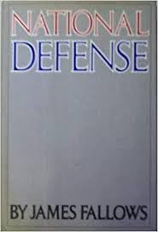
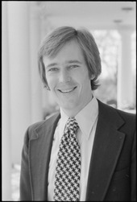
LoE #3: Direct to the Public

Slide 17
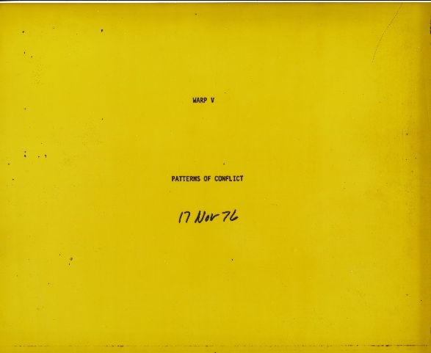
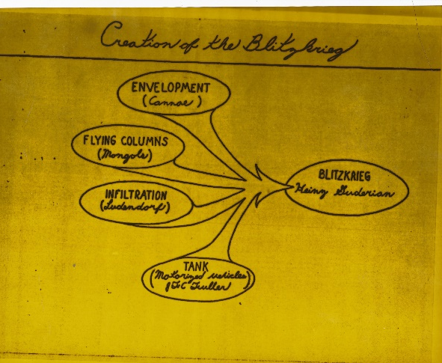
Patterns of Conflict
178 slide briefing Boyd gave many times to senior Defense and Congressional officials
Distilled lessons from social sciences and military history (Sun Tzu, Fuller, Hart, Guderian, et. al.)
Emphasized power of TIME and SHOCK – i.e., maneuver
Profoundly influenced the U.S. Marine Corps Maneuver Warfare doctrine

Slide 18
Boyd’s Legacy
Underscoring the importance of TIME and TEMPO in planning air and ground campaigns
Challenged group-think; encouraged critical thought and debate
Boyd/DRM challenges forced the USAF to refine it’s technology, reduce “gold plating”
Better aircraft, better thinking as a result, long after he left the USAF

Slide 19
Complementary Roles
i

Slide 20
Other Programs with a Creech imprint

Slide 21
Gulf War Testimony
“What Creech did, what we did, was learn how to be an air force all over again. We learned how to maintain aircraft and generate sorties, so our aircrews got enough quality training to be ready for combat. The average flying hours per month for our crews more than doubled, from less than ten to more than twenty…The equipment worked, because it was maintained with pride. Each crew chief was given ownership of his jet, and his name was painted on the side along with the pilot’s. If his jet wasn’t ready to fly on time and in perfect condition, everyone knew who was responsible. So the crew chief would not accept excuses from the supply sergeant..what you saw in Desert Storm was the legacy of Bill Creech. When F-16 squadrons flew over a hundred sorties in a single day, that was because his liberation of maintenance crews from idiotic rules and created an environment where individual initiative mattered. There is no doubt the technology you saw on the television screens during Desert Storm was impressive, but to understand the victory, you have to understand the people who operated the bases, maintained the jets, and flew them into combat. You have to know the far-reaching fire Bill Creech lit in each and every one of us in the military services.”
--Chuck Horner
Air Component Commander

Slide 22
Creech & Boyd Quotes
“Pride is the fuel of human accomplishment.” – Creech
“Any organization will be only as successful as those at the bottom are willing to make it.”
“Think big about what you can achieve; think small about how to achieve it. That's because you get things done through individuals and small groups of individuals.”
”If a man asks me for my loyalty…I will give him my honesty. If a man asks for my honesty, I will give him my loyalty.” – Boyd
“Decisions without actions are pointless. Actions without decisions are reckless.”

Slide 23
Sources
ARCHIVAL
Creech Papers (AFHRA)
Boyd Papers (Marine Corps Archive)
Coram Papers (research for Boyd)
Slife Collection (research for Creech Blue)
OSD Collection (Pentagon)
NARA II (College Park, MD)
Nellis AFB & 56th wing archives
ORAL HISTORIES
Gens. (Ret.): Walter Kross, Michael Loh, John Jumper, Ron Fogelman, Joe Ralston, Chuck Horner, Hal Hornberg
Cols. (Ret.): C.R. Anderegg, John A. Warden
Drs. Paul Kaminski, Natalie Crawford (RAND)
ASSISTANCE
Maj. Gen. James C. Slife, Walter Boyne, James T. Correll, Lt. Gen. (Ret.) Dave Deptula, Ben Lambeth, USAF Historians at Wright Patterson, Nellis, Langley, Hanscom

Slide 24
Thanh Hua Bridge
4 April 1965
8 MIG-17s down several F105Ds
F-100 may have downed a MIG
In total, trying to drop the bridge--
11 aircraft destroyed (USAF)
110 lost in the area of the bridge
Notes:
<a href="http://www.maplandia.com/vietnam/thanh-hoa/" title="satellite maps of Thanh Hoa">Thanh Hoa google satellite maps</a>

Slide 25
About the author
USAF family
BA International Relations – UCLA
Ph.D. University of North Texas
Directed field research in Afghanistan 2011-12 for DoD as part of the Human Terrain program
Associate Professor of History, Hawai’i Pacific University
Diplomatic & Military Studies Program

Slide 26
Hawai’i Pacific University
Honolulu based private university
Flagship Diplomatic & Military Studies Program
BA & MA in DMS
Blended diplomacy, strategy, and military topics
Courses
Military History to 1500
War & Society from 1500
Counterinsurgency (grad & undergrad)
U.S. Military History
Topics in American Military History
Military Historiography
Brian R. Price, Ph.D.
bprice@hpu.edu

Slide 27
Revolution in Military Affairs
By the 1970s, the Soviets noticed American advancements and began to worry
Coined the term, “Revolution in Military Affairs,” (RMA)
RMA discussion takes off during the 1980s in the United States and amongst NATO allies

